Slide 1

Sentiment Analysis of Yelp Reviews
Exploring NLP to classify customer sentiment from Yelp reviews.
LK
by Lahari Koppolu

Slide 2

Problem Statement
Customer Sentiment
Classification Task
Business Insights
Understand feelings about businesses via reviews
Positive vs. negative sentiment using NLP
Leverage sentiment to drive improvements

Slide 3
Dataset Overview
Size
Key Columns
86,000+ Yelp reviews
Review text
Star ratings
Business & user IDs

Slide 4
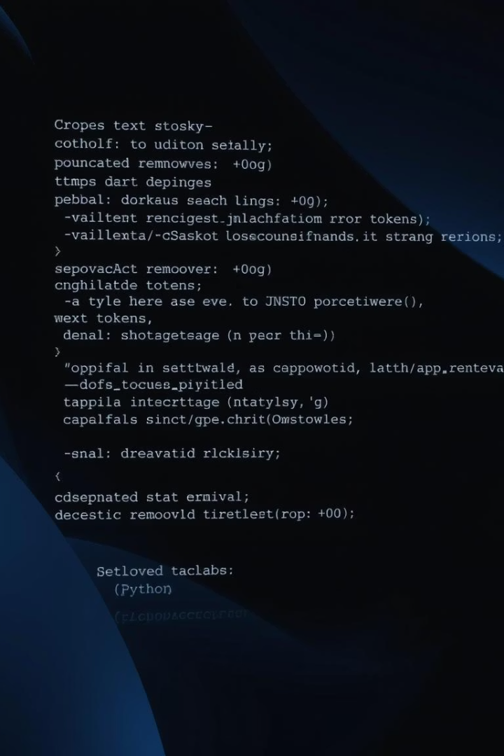
Text Cleaning & Preprocessing
Clean Text
Remove punctuation, stopwords, lowercase text
Feature Engineering
Calculate review text length
Tokenization
Extract word tokens from text

Slide 5
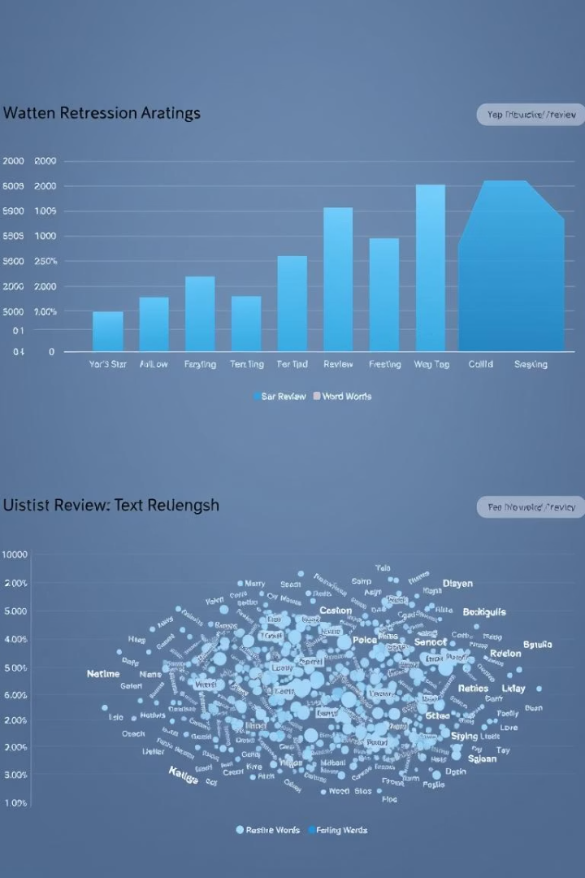



Exploratory Data Analysis
Rating Distribution
Text Length Trends
Word Frequency

Slide 6
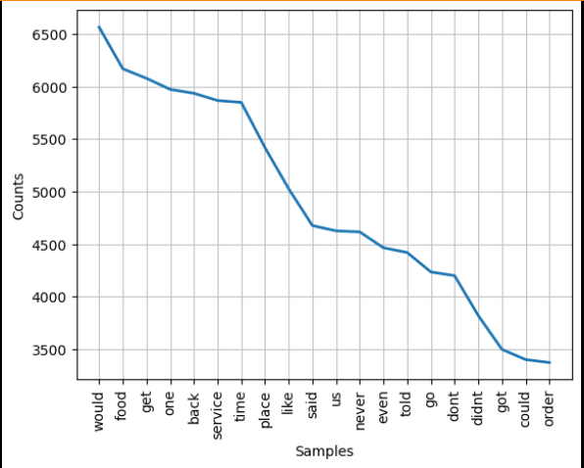
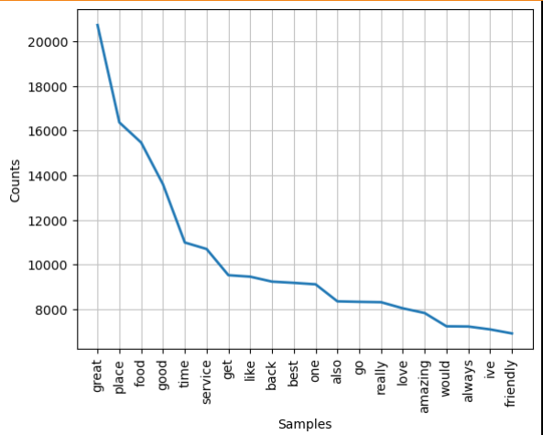
Frequently Occuring Words in Negative and Positive Reviews
WordCloud() Plot – Negative Reviews
WordClound() Plot – Positive Reviews

Slide 7
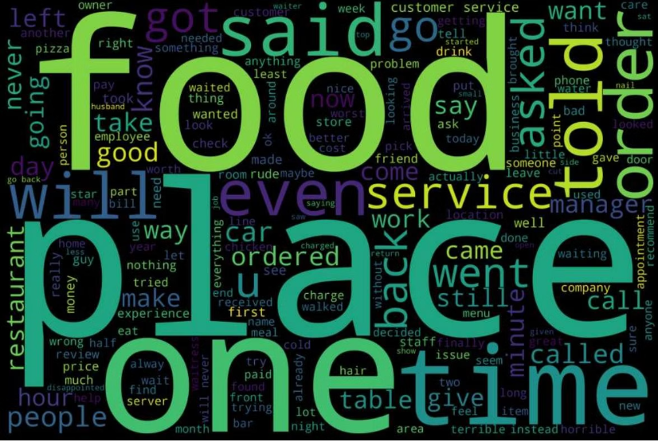
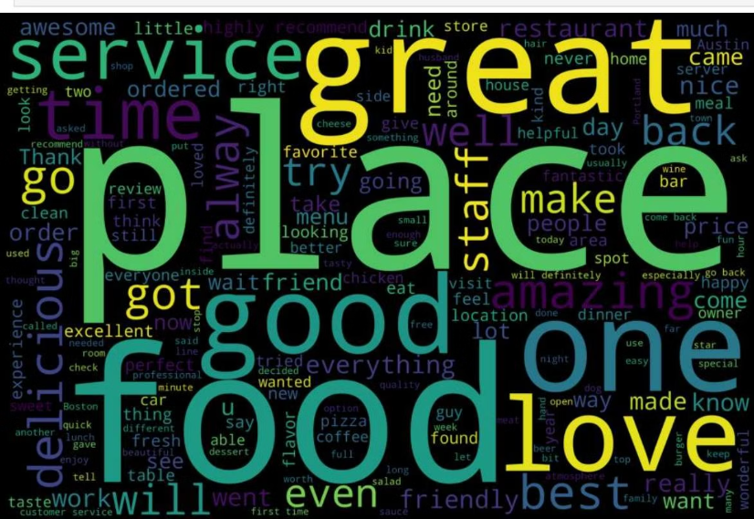
Insights from Negative and Positive Reviews
Negative Reviews
Positive Reviews
Frequent words like "place", "food", and "service" indicate areas needing improvement.
Words such as "great" and "love" dominate, reflecting customer satisfaction and positive experiences.

Slide 8
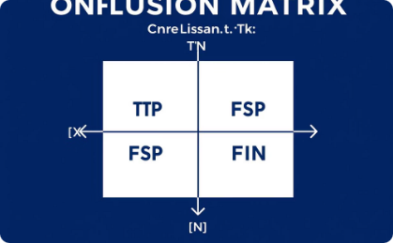
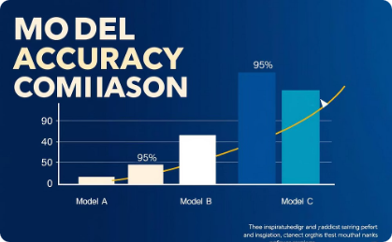
Building and Evaluating Sentiment Classification Models
Multinomial Naive Bayes
TF-IDF Vectorizer
Improved precision for 1-star reviews to 98%, but lowered 5-star precision to 85%, resulting in overall lower accuracy.
Achieved 92.5% accuracy classifying 1 and 5 star reviews, with high precision and recall, especially for 5-star reviews.

Slide 9

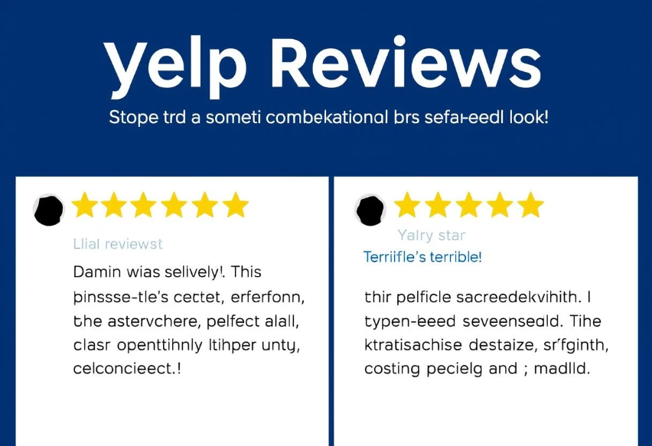
Random Forest Classifier and Model Predictions
Random Forest Results
Model Predictions
Achieved 88.9% accuracy with balanced precision and recall for both positive and negative reviews, showing potential for improved performance.
The Multinomial Naive Bayes model accurately predicted star ratings for sample positive and negative reviews, demonstrating practical application of sentiment analysis.
This project highlights how text analysis and machine learning can extract meaningful insights from customer reviews to support business decisions.

Slide 10
Key Insights & Conclusion
Keyword Trends
Conclusion
Negative: food, service, place
Simple NLP models yield actionable business feedback
Positive: amazing, love, great, friendly
Sentiment informs targeted service improvements

